Slide 1


CA ELD Standards
Essence & Differentiation
Multilingual and multicultural education department

Slide 2
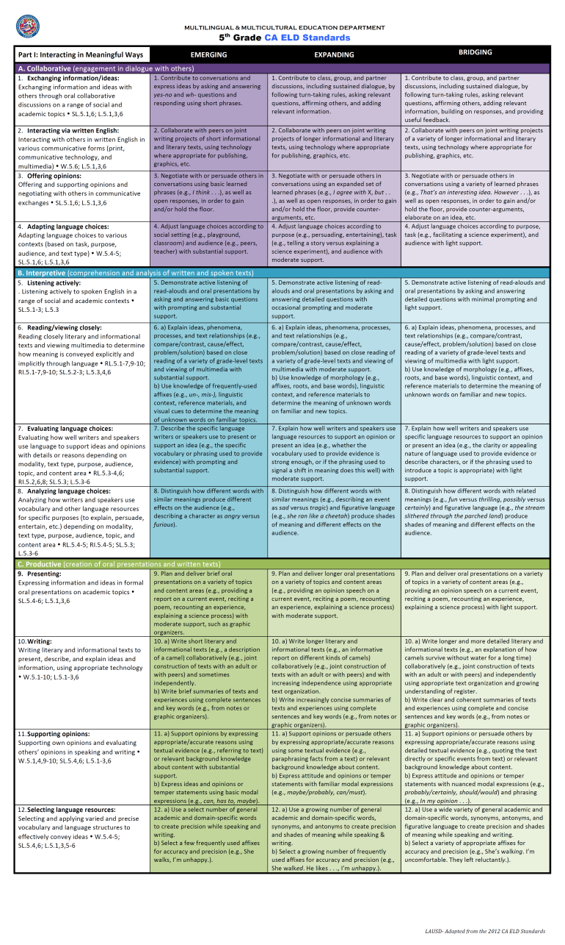
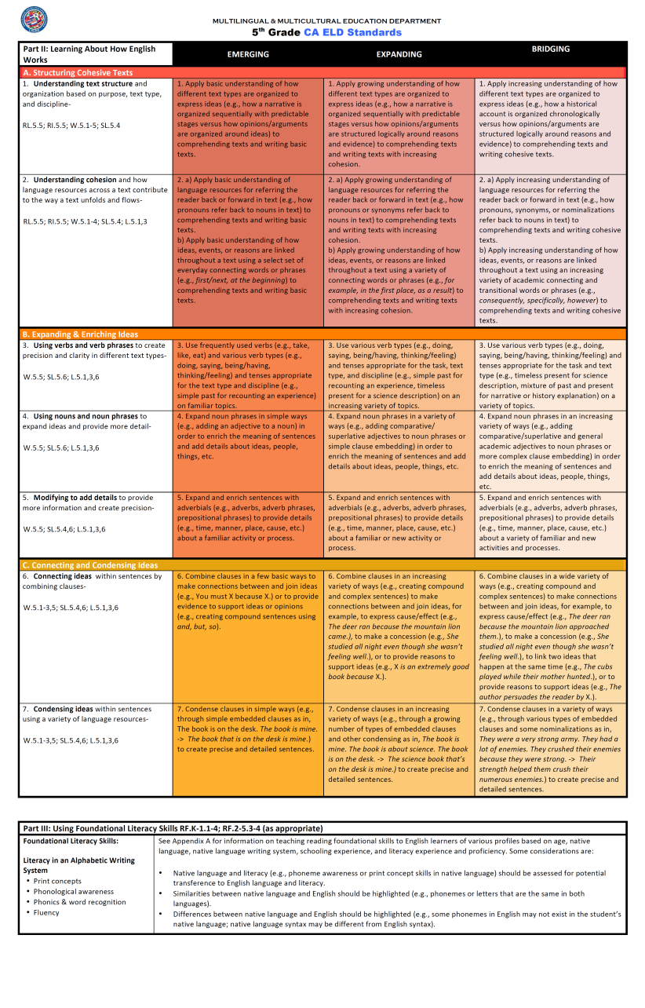
2012 CA ELD Standards
Notes:
2 min.
(Handout)
Distribute Standards at a Glance for 3rd grade (Elementary) or 8th Grade (Secondary). Here are the Standards at a Glance Cards – these are grade level specific.
I will model using the 3rd grade Standards at a glance

Slide 3

Part I: Interacting in Meaningful Ways
3 Modes
  Collaborative
  Interpretive
  Productive
Strands
CCSS
i.e. SL.K.1
Proficiency levels
Language of the Standards
Part I: Interacting in Meaningful Ways
Part I: Interacting in Meaningful Ways
Notes:
2 min.
Here are the Standards at a Glance Cards – these are grade level specific.
The first side (purple, blue, green) is the Part I: Interacting in Meaningful Ways.
Notice the three modes:
Collaborative
Interpretive
Productive
Note that the strand is a K-12 description of what the standard is about. It is not the essence for the grade level. Also note the CCS Language arts connection by grade level. Next, note that there are 3 proficiency levels-Emerging, Expanding and Bridging. Under each is the language of the grade level standard. Also note that the shading of the colors go from deep to light to represent the decreasing level of scaffolding or support.

Slide 4
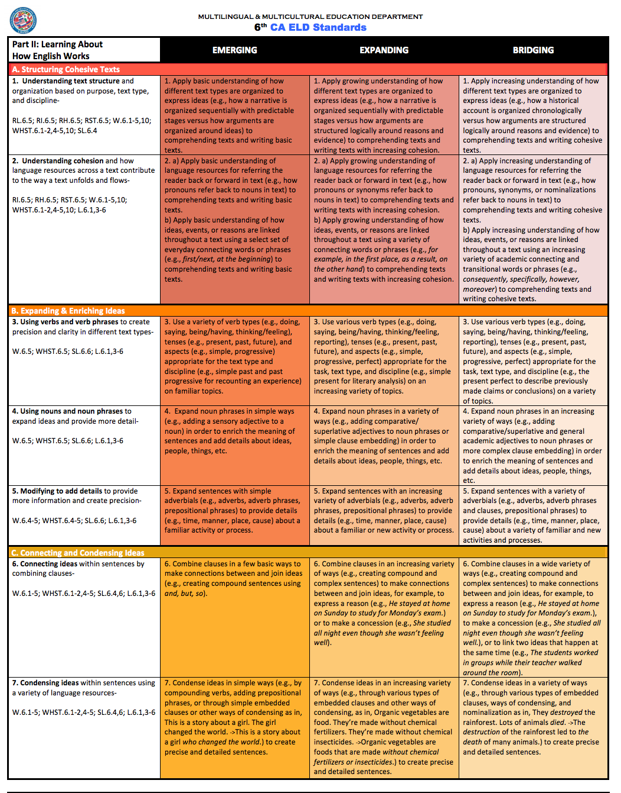
Part II: Learning About How English Works
3 Processes
  Structuring Cohesive Texts
  Expanding and Enriching Ideas
  Connecting and Condensing Ideas
Strands
CCSS
i.e. SL.2.1
Proficiency levels
Language of the Standards
Part II: Learning About How English Works
Part II: Learning About How English Works
Notes:
: 2 min.
Here are the Standards at a Glance Cards – these are grade level specific.
On the back (shades of orange) is the Part II: Learning About How English Works.
Notice the three language processes:
Structuring Cohesive Text
Expanding & Enriching Ideas
Connecting and Condensing Ideas
Note that the strand is a K-12 description of what the standard is about. It is not the essence for the grade level. Also note the CCS Language arts connection by grade level. Next, note that there are 3 proficiency levels-Emerging, Expanding and Bridging. Under each is the language of the grade level standard. Also note that the shading of the colors go from deep to light to represent the decreasing level of scaffolding or support.
At the bottom is Part III: Using Foundational Literacy Skills

Slide 5


Essence of the Standards
Part I: Interacting in Meaningful Ways
Notes:
30 seconds
Understanding the essence of the standards is essential to understanding ELPAC, as the ELPAC is aligned to the CA ELD Standards.

Slide 6
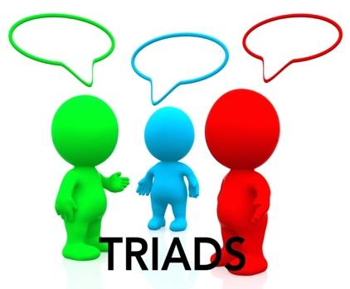
CA ELD Standards – Part I
What?
Read: Essence of the CA ELD Standards
How?
Jigsaw Triad Activity
in Grade Level group
Partner A: Collaborative Mode
Partner B: Interpretive Mode
Partner C: Productive Mode
Let’s Model….
Notes:
Time: 4 min. for explanation and composition of the triad
Have participants use their fingers to locate others in their grade level.
Purpose: Participants will understand and dig in deeper to the language of the standards and the essence of Part I-Interacting in Meaningful Ways.
Ensure that all participants are in a group of three to ensure that each part of the standards is represented.
Have partners assign themselves A, B, or C role.
Verify by calling letters and having them raise their hand.
Strand 1 will be modeled

Slide 7
Notes:
2 min.
I will model the role of Partner A. When I look at the strand, the general description for all grades, (Point to Standards at a Glance far left column) it says this:
(click)
Now, I go to the Expanding level because this is the level from which the standard was written and then differentiated up for Bridging and down for Emerging.

Slide 8
Notes:
2 minutes
1 minute
But what is the actual language of the standard? I will read the language of the standard at the Expanding level to find 3-4 words to render the standard to its essence.
Purpose: focus on the Standard and the language of the standard at the expanding level
Click
Box will show the standard
Read the standard
There are 3 proficiency levels in the new CA ELD Standards.
Analyze the grade specific standards for its essence. at the expanding level only.
For this activity you will focus at the expanding level only
Click
The essence of the standard is underlined

Slide 9
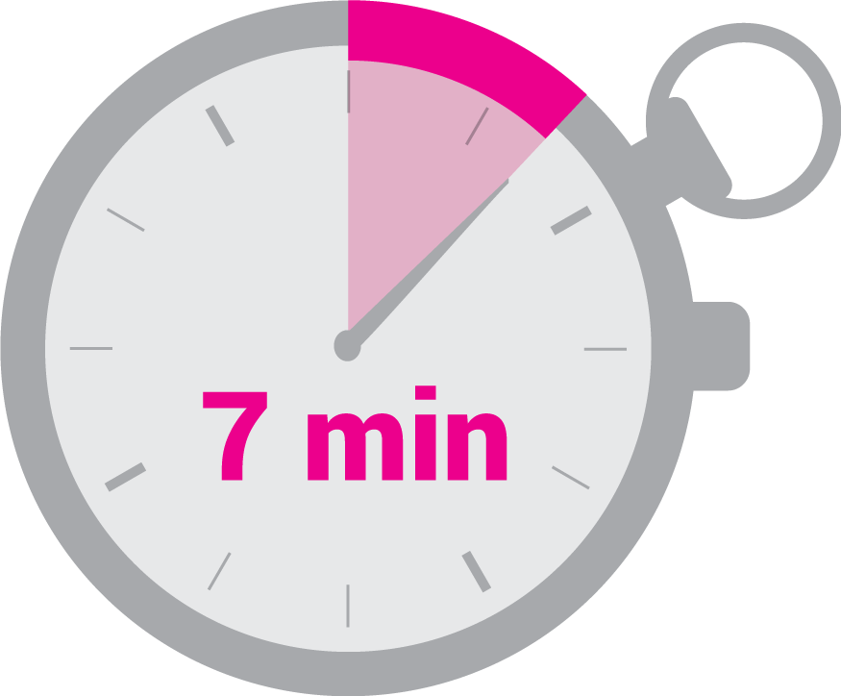

CA ELD Standards – Part I
Contribute to class discussions
Read the CA ELD Standards at Expanding Level for your assigned Mode
Write the essence of each standard at the Expanding Level on the top line for the standard
Share with your group in order
Be prepared to share whole group
Notes:
Time: 9 min.
So I will write my essence on the top highlighted line for the standard. The essence goes across the proficiency levels. Have participants write the essence for their grade.
Remind participants of their mode-A Partner: Collaborative, B Partner: Interpretive, C Partner: Productive.
Give participants 1 mins. 20 seconds to write their essences. Check in with Finger Minutes Strategy and give them the average based on their fingers.
If question arises about a standard with a, b, c, etc., let participants know that they may do four words for each or may look at the a, as it is the message level essence, and the others go deeper to the sentence and word level
A, B, C hierarchy level
A: message level/discourse level
B: sentence/phrase level
C: morphology or word level
Whole Group share out
Check to see what questions or comments participants have.

Slide 10
Proficiency Level Scaffolding
Part I: Interacting in Meaningful Ways
EMERGING
EXPANDING
BRIDGING
Notes:
Time: 30 seconds
Understanding the essence of the standards is essential to understanding ELPAC and its alignment to the standards.
Understanding the different scaffolding between Emerging, Expanding, and Bridging is essential to providing differentiated instruction to prepare students for success in ELPAC.
Your group will work together now on each standard to understand the progression in scaffolds for each proficiency level

Slide 11
Proficiency Level Scaffolding
Read each proficiency level with your triad
Highlight the essence of the standard for each Proficiency Level
Agree Upon and Underline the differences within each proficiency level
Write a short phrase (3-4 words) that captures the difference between each proficiency level
Let’s Model….
Notes:
Time: 2 min.
Distribute grade level Progress Report Card Scoring Protocol Sheet to each participant. We will annotate and write the essence of our annotations to understand the difference between the proficiency levels. You will work together with your triad to come to an agreement on the scaffolds by proficiency level.
I will model what this looks like.

Slide 12
Model the Process
Highlight the essence your triad agrees upon for all levels
Notes:
Time: 2 mins.
Model with two participants. Say: We are a triad.
First, my triad agrees upon the essence of the standard across the proficiency levels. Say to triad model: What is the essence of the standard? I remember I decided that contribute to class discussions was the essence. Let’s check together by looking at Emerging and Bridging. But how does the scaffolding and student output change across levels? Do we agree that this is the essence? Let’s highlight across. Talk to your Triad for your grade level. Highlight the essence you agree upon.

Slide 13
Model the Process
Agree Upon and Underline the student output differences for each proficiency level
Notes:
Time: 2 mins.
Now, let’s look at the scaffolds across proficiency levels. What are the key words? Let’s agree with our triad. I underline the key differences between each level. Click animation to show. Now look at your grade level and highlight the changes from Emerging to Expanding to Bridging. Now, with my triad, we decide what is the essence of each scaffold. Model speaking to triad: I think the essence of the Emerging scaffolding for this standard is asking yes/no & wh-questions. What do you think? What might be the essence of the scaffold for Expanding? Let’s come to a consensus.

Slide 14
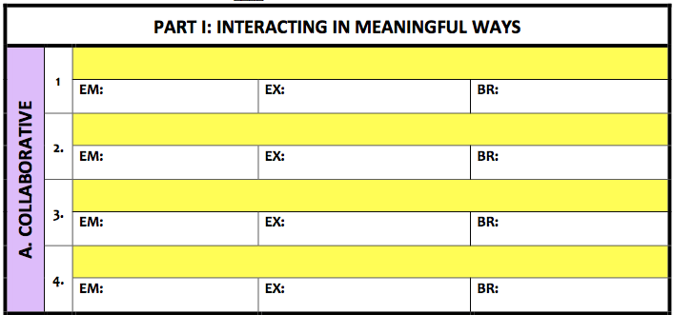
Model the Process
Contribute to class discussions
asking yes/no & wh-questions
add & asking relevant information
building on responses & provide feedback
Handout
Notes:
Time: 2 mins.
So now I write the student output differentiation based on the proficiency level of each on the second row of the standard. Now do the same with your grade level.
K-2 is grappling with the basic concept
and independence
3-6 have the concepts and you are applying to the content

Slide 15
CA ELD Standards – Part I
Contribute to class discussions
asking yes/no & wh-questions
add & asking relevant information
building on responses & provide feedback
Read each proficiency level with your triad
Highlight the essence of the standard for each Proficiency Level
Agree Upon and Underline the differences within each proficiency level
Write a short phrase (3-4 words) that captures the difference between each proficiency level
Be prepared to share whole group
Notes:
Time: 15 min.
Read directions. Check in with finger minutes at 10 minutes. Most likely they will need more time.

Slide 16
Essence of the Standards
Part II: Learning About How English Works
Notes:
30 seconds
Understanding the essence of the standards is essential to understanding ELPAC.

Slide 17
CA ELD Standards - Part II
What?
Read: Essence of the CA ELD Standards
How?
Jigsaw Triad Activity
in Grade Level group
Partner A: Structuring Cohesive Texts
Partner B: Expanding and Enriching Ideas
Partner C: Connecting and Condensing Ideas
Let’s Model….
Notes:
Time: 2 minutes for explanation and composition of the triad
Purpose: Participants will understand and dig in deeper to the language of the standards and the essence of Part I-Interacting in Meaningful Ways.
Ensure that all participants are in a group of three to ensure that each part of the standards is represented.
Have partners assign themselves A, B, or C role.
Verify by calling letters and having them raise their hand.
Standard B 3 will be modeled

Slide 18
STRUCTURE/ WHAT
PURPOSE/ WHY?
Notes:
2 min.
When we look at the Part II standards, we need to think about the Structure or the What and the Purpose or the Why of the standard.

Slide 19
STRUCTURE/ WHAT
PURPOSE/ WHY?
Notes:
2 minutes
Purpose: focus on the Standard and the language of the standard at the expanding level
Click
The structure (what) and purpose (why) of the standard is underlined.
Look at the standard for your grade level. What do you notice?

Slide 20
CA ELD Standards - Part II
Read the CA ELD Standards at Expanding Level for your assigned Process
Write the essence of each standard at the Expanding Level on the top line for the standard
  Think about “the what” and the “Why”
  Share with your group in order
Be prepared to share whole group
Verb types/tenses to convey time
Notes:
Time: 9 min.
So I will write my essence on the top line for the standard. The essence goes across the proficiency levels. Have participants write the essence for their grade.
Remind participants of their mode-A Partner: Collaborative, B Partner: Interpretive, C Partner: Productive.
Give participants 1 mins. 20 seconds To write their essences
Assign timekeeper. Each member has 2 mins. To share their essences
If question arises about a standard with a, b, c, etc., let participants know that they may do four words for each or may look at the a, as it is the message level essence, and the others go deeper to the sentence and word level
a,b,c hierchary level
A: message level/discourse level
B: sentence/phrase level
C: morphology or word level
Whole Group share out
Check to see if participants have any questions or comments

Slide 21
Proficiency Level Scaffolding
Part II: Learning About How English Works
EMERGING
EXPANDING
BRIDGING
Notes:
Time: 30 seconds
Understanding the essence of the standards is essential to understanding ELPAC and its alignment to the standards.
Understanding the differentiation between Emerging, Expanding, and Bridging is essential to providing differentiated instruction to prepare students for success in ELPAC.

Slide 22
Proficiency Level Scaffolding
Read each proficiency level with your triad
Highlight the essence of the standard for each Proficiency Level
Agree Upon and Underline the differences within each proficiency level
Write a short phrase (3-4 words) that captures the difference between each proficiency level
Let’s Model….
Notes:
Time: 2 min.
This is the process that we will use to understand the difference between the proficiency levels.
We will now refer to the grade level Progress Report Card Scoring Protocol Sheet to annotate. We will render our annotation I will model what this looks like.

Slide 23
Model the Process
Highlight the essence your triad agrees upon for all levels
Notes:
Time: 2 mins.
Model with two participants. Say: We are a triad.
First, my triad agrees upon the essence of the standard across the proficiency levels. Say to triad model What is the essence of the standard? I remember I decided that verb types/tenses to convey time was the essence. Let’s check together by looking at Emerging and Bridging. Additionally, how does the scaffolding change across levels? Do we agree that this is the essence? Let’s highlight across. Talk to your Triad for your grade level. Highlight the essence you agree upon.

Slide 24
Model the Process
Agree Upon and Underline the student output differences for each proficiency level
Notes:
Time: 2 mins.
Now, let’s look at the scaffolds across proficiency levels. What are the key words? Let’s agree with our triad. I underline the key differences between each level. Click animation to show. Now look at your grade level and highlight the changes in student output from Emerging to Expanding to Bridging. Now, with my triad, we decide what is the essence of each scaffold. Model speaking to triad: I think the essence of the Emerging scaffolding for this standard is frequently used verbs and simple past for recounting experience. What do you think? What might be the essence of the scaffold for Expanding? Let’s come to a consensus.

Slide 25
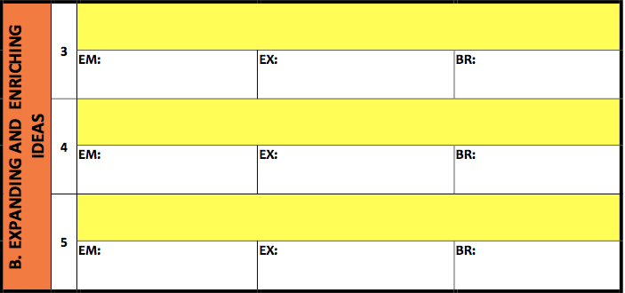
Model the Process
Verbs types/tenses convey time
Frequently used (e.g., simple past)
Growing number (e.g., simple present)
Variety of (e.g., simple future)
Notes:
Time: 2 mins.
So now I write the essence of each on the second row of the standard. Now do the same with your grade level.
K-2 is grappling with the basic concept
and independence
3-6 have the concepts and you are applying to the content

Slide 26
CA ELD Standards - Part II
Read each proficiency level with your triad
Highlight the essence of the standard for each Proficiency Level
Agree Upon and Underline the differences within each proficiency level
Write a short phrase (3-4 words) that captures the difference between each proficiency level
Be prepared to share whole group
Verbs types/tenses convey time
Frequently used (e.g., simple past)
Growing number (e.g., simple present)
Variety of (e.g., simple future)
Notes:
Time: 15 min.
Read directions. Check in with finger minutes at 10 minutes. Most likely they will need more time.

Slide 27

How will you use the CA ELD Standards and Proficiency Levels to scaffold instruction?
Notes:
Time: 3 mins.
Have participants share how they will use this information with their elbow partner.
Have 1-2 share whole group.

